Slide 1
CS112 : Introduction to Python Programming
Week 13: lab practice

Slide 2
Practice 1
Read screening01.csv into DataFrame
Group by age(>60y,<=60y) and gender, calculate the number of person having smoking and drinking.

Slide 3
Practice 2
Read the screening02.csv file. Merge the grouped data from Practice 1 with the ID.calculate the mean BMI of person with the status of drinking,smoking, gender and age(>60y,<=60y). output the result as a dataframe.
variable | geroup | mean
age | >60
 | <=60
drinking | yes
 | no
...

Slide 4
Practice 3
在screning02.csv file中， 按照表中位置的前三分之一、中间三分之一和后三分之一分组，统计 BMI的均值。

Slide 5
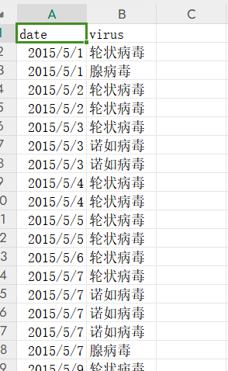
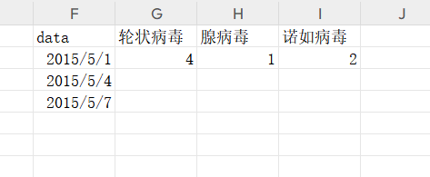
Practice 4
Read the test_virus.csv as a DataFrame. Pivot the table using date as index, virus as columns and counts in every 3 days as values.

Slide 6
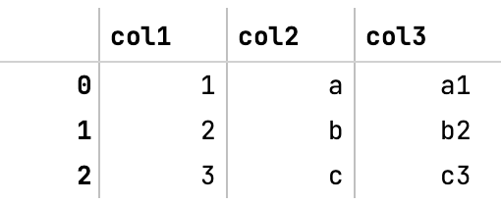
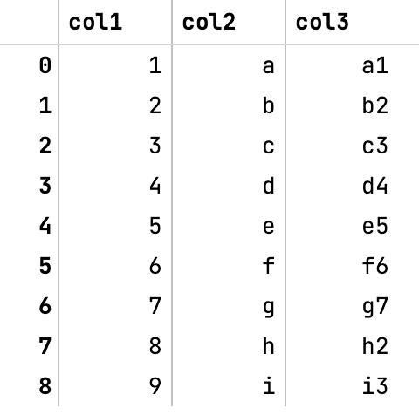
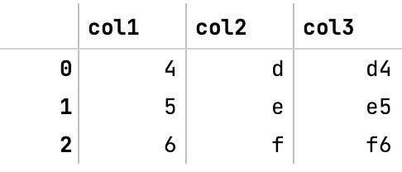
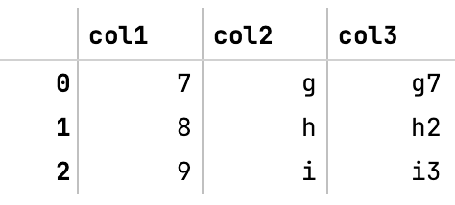
Practice 5
Concat the following DataFrames:
df1 = pd.DataFrame({'col1': [1, 2, 3], 'col2': ['a', 'b', 'c'], 'col3': ['a1', 'b2', 'c3']})
df2 = pd.DataFrame({'col1': [4, 5, 6], 'col2': ['d', 'e', 'f'], 'col3': ['d4', 'e5', 'f6']})
df3 = pd.DataFrame({'col1': [7, 8, 9], 'col2': ['g', 'h', 'i'], 'col3': ['g7', 'h2', 'i3']})

